Slide 1

Unraveling Heat Stress-Induced Disruption of LCA5L, MYBL1, and MAGEB4 Pathways in Mammalian Spermatogenesis
Melanie L Salas
Notes:
A Multi-Omics Study in Knockout Mice
LCA5L, MYBL1, and MAGEB4 were chosen because they are key regulators in sperm development and stress response.
LCA5L is essential for testicular integrity and spermatogenesis.
MYBL1 controls gene expression during germ cell differentiation and DNA repair.
MAGEB4 protects cells from oxidative stress, crucial under heat stress.
These genes are central to understanding how heat and environmental stressors disrupt male fertility.

Slide 2
Impact of Environmental Stressors On Male Fertility
Key Issue: Environmental stressors (heat, pollution, endocrine disruptors) are reducing male fertility.
Scientific Basis
Spermatogenesis is highly sensitive to heat stress.
Leads to sperm dysfunction and reduced fertility.
Knowledge Gap
Molecular mechanisms of heat-induced infertility remain unclear.
Research Goal
Investigate the roles of LCA5L, MYBL1, and MAGEB4 in sperm resilience to heat stress
Notes:
Environmental stressors (heat, pollution, endocrine disruptors) reduce male fertility.
Heat stress affects spermatogenesis → sperm dysfunction.
Knowledge gap: Molecular mechanisms unclear.
Goal: Study LCA5L, MYBL1, MAGEB4 in sperm resilience to heat.
This study examines how heat and environmental stress impair male fertility by disrupting three key genes: LCA5L (linked to sperm tail structure), MYBL1 (regulates germ cell division), and MAGEB4 (involved in sperm maturation). Using knockout mice and multi-omics tools, it explores how loss of these genes affects sperm quality, gene expression, and fertility.
how environmental stressors — like heat, pollution, and endocrine disruptors — are contributing to the decline in male fertility.
Spermatogenesis is extremely sensitive to heat stress, which can impair sperm function and lower fertility.
Despite this, the molecular pathways driving heat-induced infertility remain unclear.
I aim to study three key genes — LCA5L (structural integrity), MYBL1 (transcription regulation), and MAGEB4 (stress response) — to understand their roles in protecting sperm under thermal stress.
Using knockout mice and multi-omics analysis, this research will help uncover how loss of these genes affects sperm quality, gene expression, and long-term fertility."

Slide 3
Central Hypothesis
Thermal stress disrupts spermatogenesis via conserved and species-specific molecular pathways mediated by LCA5L, MYBL1, and MAGEB4, compromising male fertility and inducing transgenerational effects.
Notes:
We hypothesize that thermal stress disrupts spermatogenesis through both conserved and species-specific molecular pathways, mediated by LCA5L, MYBL1, and MAGEB4. This disruption compromises male fertility and may have transgenerational effects

Slide 4
Aim 1 – Heat Stress & Germ Cell Survival
Investigate how heat stress disrupts LCA5L, MYBL1, and MAGEB4 pathways, affecting germ cell survival.
Approach:
Mouse models: WT & KO mice under heat stress (39-42°C).
Methods: scRNA-seq, ATAC-seq, proteomics, TUNEL assays, immune staining, sperm analysis.
Expected Outcomes:
Identify disrupted pathways affecting germ cell survival.
Provide insights for fertility preservation.
Notes:
Objective:
Investigate how heat stress affects LCA5L, MYBL1, and MAGEB4 pathways, impacting germ cell survival.
Approach:
Mouse models: WT & KO mice exposed to heat stress (39-42°C).
Methods:
scRNA-seq: Analyzes gene expression at the single-cell level.
ATAC-seq: Examines chromatin accessibility and gene activation.
TUNEL assays: Detects DNA fragmentation to assess cell death.
Sperm analysis: Evaluates sperm quality and viability.
Immune statining: Markers- germ cells, DSD, stromstogonic cells, proliferation and double strand D, spermatogenesis (Look for genes)
Expected Outcomes:
Identify disrupted pathways and their impact on germ cell survival.
Provide insights for fertility preservation.

Slide 5
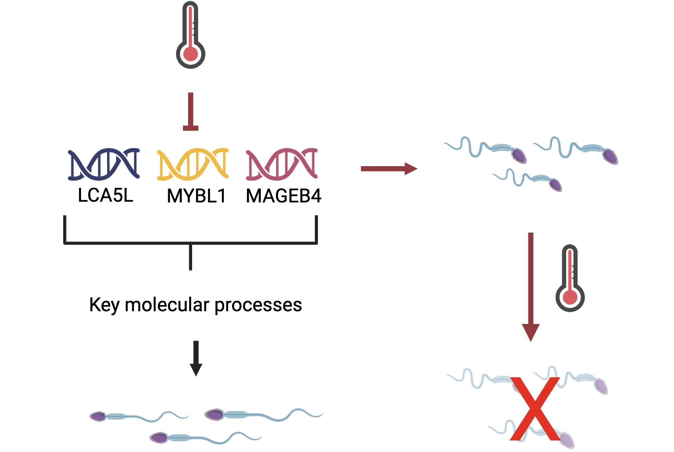
Notes:
Heat stress disrupts LCA5L, MYBL1, and MAGEB4 pathways, impairing spermatogenesis and germ cell survival. The absence of these genes is expected to disrupt key molecular processes necessary for germ cell development, making cells more vulnerable to heat-induced damage, leading to reduced sperm production and increased germ cell loss.

Slide 6
Aim 2 – Transcriptomic & Epigenomic Disruptions
Objective:
Examine how loss of LCA5L, MYBL1, MAGEB4 exacerbates heat-induced gene regulation and chromatin remodeling defects.
Approach
Methods: RNA-seq, qPCR, ChIP-seq, ATAC-seq, SCSA for sperm quality.
Expected Outcomes:
Identify heat-sensitive gene networks & chromatin changes.
Understand impacts on fertility & potential transgenerational effects.
Notes:
Approach and Methods:
RNA-seq:
Identify gene expression changes due to heat stress in cells lacking LCA5L, MYBL1, or MAGEB4.
qPCR:
Validate key gene expression changes from RNA-seq.
ChIP-seq: (Chromatin Immunoprecipitation sequencing)
Examine chromatin modifications and transcription factor binding in response to heat stress.
ATAC-seq: (Assay for Transposase-Accessible Chromatin sequencing)
Measure chromatin accessibility to identify heat-sensitive regions.
SCSA: (Sperm Chromatin Structure Assay for Sperm quality)
Assess sperm DNA quality to evaluate fertility impacts.

Slide 7
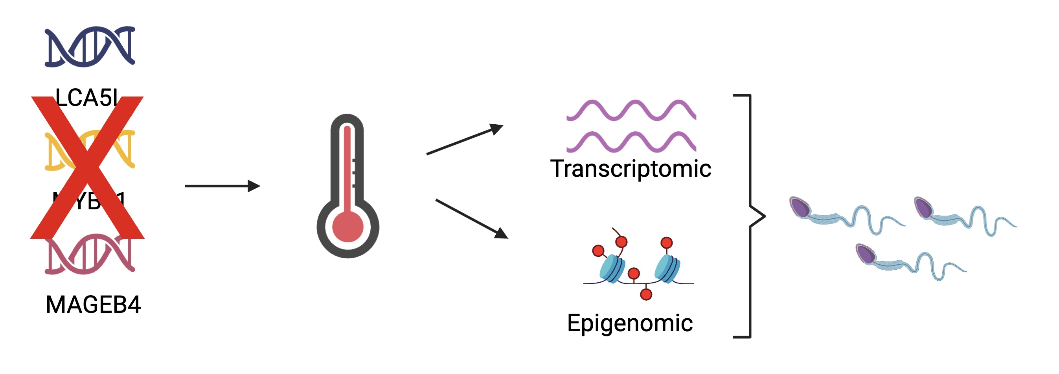
Notes:
The loss of LCA5L, MYBL1, and MAGEB4 exacerbates heat-induced transcriptomic and epigenomic changes in germ cells, reducing sperm quality and morphology. Without these genes, essential regulatory networks involved in gene expression and chromatin structure will be more susceptible to heat stress, leading to defects in sperm formation and function.

Slide 8
Aim 3 – Oxidative Stress & Protein Homeostasis
Objective:
Investigate the role of LCA5L, MYBL1, and MAGEB4 in protecting germ cells from oxidative stress & protein aggregation.
Approach
Methods: ROS detection (DHE, MitoSOX), DNA damage assays, protein aggregation markers, sperm viability tests.
Expected Outcomes:
Identify disrupted oxidative stress & protein homeostasis pathways.
Determine sperm function impairment due to gene loss.
Notes:
Reactive Oxygen Species
ROS detection (DHE, MitoSOX): Measure general ROS (DHE) and mitochondrial ROS (MitoSOX) to assess oxidative stress.
DHE (Dihydroethidium): A fluorescent dye that detects general ROS by emitting fluorescence when oxidized.
MitoSOX: A specific fluorescent dye for detecting mitochondrial ROS, highlighting oxidative stress within mitochondria.
DNA damage assays: Detect DNA damage markers (e.g., phosphorylated H2AX) to assess genomic integrity.
Protein aggregation markers: Identify protein clumping using markers like ubiquitin to evaluate stress-related aggregation.
Sperm viability tests: Assess sperm health and function using motility and membrane integrity tests.

Slide 9
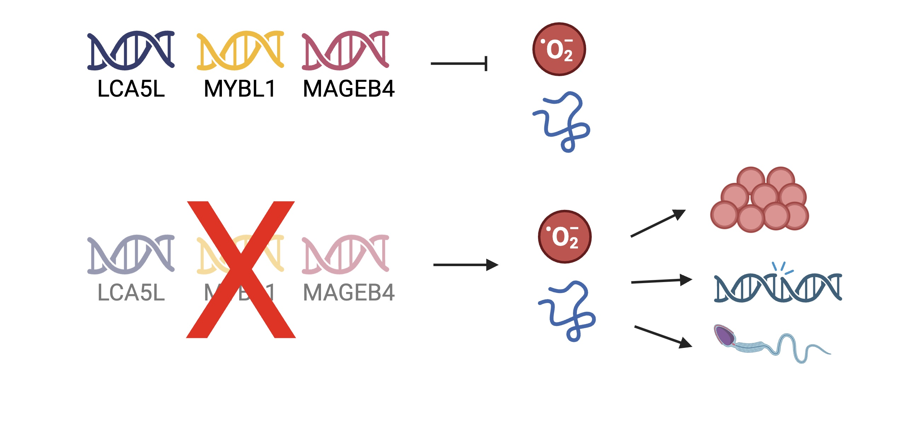
Notes:
These genes play a critical role in protecting germ cells from oxidative stress and protein misfolding. Their absence increases cellular vulnerabilities under heat stress by triggering oxidative damage and disrupting protein homeostasis. We predict that the loss of these protective mechanisms will result in protein aggregation, DNA damage, and impaired sperm viability.

Slide 10
Impact and Future directions
Scientific Contributions: Uncover conserved mechanisms of heat-induced sperm dysfunction.
Applications:
Biodiversity conservation, livestock fertility management, human reproductive health.
Next Steps:
Develop targeted fertility preservation strategies.
Notes:
Understanding how LCA5L, MYBL1, and MAGEB4 protect sperm development could reveal new biomarkers or therapeutic targets for diagnosing and treating male infertility, especially in the context of rising global temperatures. Future work may explore how to reverse or prevent these gene disruptions and apply findings to human reproductive health and environmental policy.

Slide 11

THANK YOU
Notes:
PLAN B doing survivals with Melissa

Slide 12
References
Murat, F., Mbengue, N., Winge, S. B., Trefzer, T., Leushkin, E., Sepp, M., Cardoso-Moreira, M., Schmidt, J., Schneider, C., Mößinger, K., Brüning, T., Lamanna, F., Belles, M. R., Conrad, C., Kondova, I., Bontrop, R., Behr, R., Khaitovich, P., Pääbo, S., … Kaessmann, H. (2022, December 21). The molecular evolution of spermatogenesis across mammals. Nature News. https://www.nature.com/articles/s41586-022-05547-7
Mailin G;Yang Y;Liu C;Jing Y;Wang Y;Ma J;Liao T;Shen L;Zhu L; (n.d.). The RNA-seq mapping of testicular development after heat stress in sexually mature mice. Scientific data. https://pubmed.ncbi.nlm.nih.gov/39179570/
Hirano, K., Nonami, Y., Nakamura, Y., Sato, T., Sato, T., Ishiguro, K., Ogawa, T., & Yoshida, S. (2022, May 26). Temperature sensitivity of DNA double-strand break repair underpins heat-induced meiotic failure in mouse spermatogenesis. Nature News. https://www.nature.com/articles/s42003-022-03449-y
Nakagiri H, Ogawa T, Ikeda N, Terasaka S, Nukada Y, Miyazawa M. Application of testicular organ culture system for the evaluation of spermatogenesis impairment. Sci Rep. 2024 Sep 16;14(1):21581. doi: 10.1038/s41598-024-71561-6. PMID: 39285184; PMCID: PMC11405715.
Ibtisham F, Cham TC, Fayaz MA, Honaramooz A. Effects of Growth Factors on In Vitro Culture of Neonatal Piglet Testicular Tissue Fragments. Cells. 2023 Sep 8;12(18):2234. doi: 10.3390/cells12182234. PMID: 37759457; PMCID: PMC10526381.

